Slide 1
REAL POWER - FREQUENCY CONTROL
Dr.R.Muthukumar, ASP /EEE
Power System Operation and Control

Slide 2
Basics of speed governing mechanism and modeling - speed-load characteristics – load sharing between two synchronous machines in parallel - control area concept - LFC control of a single-area system - static and dynamic analysis of uncontrolled and controlled cases - two-area system – modeling - static analysis of uncontrolled case - tie line with frequency bias control - state variable model - integration of economic dispatch control with LFC.
Power System Operation and Control

Slide 3


Fundamentals of Speed Governing System
Steam
Lower
Speed changer
X_{C}
X_{B}
X_{D}
To Turbine
Raiser
l₂
l₃
X_{E}
l₁
X_{A}
l₄
Steam valve
Pilot valve
High pressure oil
Main piston
Speed Governor
Hydraulic amplifier
Power System Operation and Control

Slide 4
Fundamentals of Speed Governing System
The system consists of following components
  Fly ball governor
  Hydraulic amplifier
  Linkage mechanism
  Speed changer
Power System Operation and Control

Slide 5
Fundamentals of Speed Governing System
Fly ball speed governor:
  This is the heart of the system which senses the change in speed(frequency).
  As the speed increases the fly ball move outwards and the point B on linkage mechanism moves downwards. The reverse happens when the speed decreases.
Hydraulic amplifier:
  It consists of pilot value and main piston.
  Low power level pilot value movement is converted into high power level pilot value.
  This is necessary in order to open or close the steam value against high pressure system.
Power System Operation and Control

Slide 6
Fundamentals of Speed Governing System
Linkage mechanism:
  A,B,C is a rigid link pivoted at CDE in another rigid kink pivoted at D.
  This link mechanism provides a movement to control value in proportion to the change in speed.
Speed Changer:
  It provides a steady state power output setting for the turbine.
  Its downward movement opens the upper pilot value so that more steam is admitted to the turbine under steady state condition.
  The reverse happens for upward movement of speed changer.
Power System Operation and Control

Slide 7


Speed Governor modal
The governor compensates for changes in the shaft speed
  changes in load will eventually lead to a change in shaft speed
  change in shaft speed is also seen as a change in system frequency
Power System Operation and Control

Slide 8

Turbine model
The prime mover driving a generator unit may be a steam turbine or a hydro turbine.
The models for the prime mover must take account of the steam supply and boiler control system characteristics in the case of steam turbine on the penstock for a hydro turbine
The dynamic response of steam turbine in terms of changes in generator power output ΔP_{G} to change in steam valve opening ΔX_{E}
Power System Operation and Control

Slide 9


Generator load or Power system model
To develop the mathematical model of an isolated generator, which is only supplying local load and is not supplying power to another area,
Suppose there is a real load change of ΔP_{D} .
Due to the action of the turbine controllers, the generator increases its output by an amount ΔP_{G} .
The net surplus power (ΔP_{G} - ΔP_{D} ) will be absorbed by the system in two ways.
  By increasing the kinetic energy in the rotor at the rate
  As the frequency changes, the motor load changes being sensitive to speed, the rate of change of load w.r.t frequency f
Power System Operation and Control

Slide 10


Generator load or Power system model
Power System Operation and Control

Slide 11
Model of Load frequency control of single area
Speed Governor
Turbine
Power system
Complete Block diagram representation of LFC
Power System Operation and Control

Slide 12
Speed-Load characteristics
The isochronous governors cannot be used when there are two or more units connected to the same system since each generator would have to precisely the same speed setting.
For stable load sharing between two or more units operating in parallel, the governors are provided with a characteristics so that the speed drops as the load in increased.
Percent speed regulation or droop:
  The value of R determine the steady state speed versus load characteristics of generating unit. The ratio of speed deviation(Δω) or frequency deviation (Δf) to change in valve/gate position (ΔY) or power output (ΔP) is equal to R.
Power System Operation and Control

Slide 13
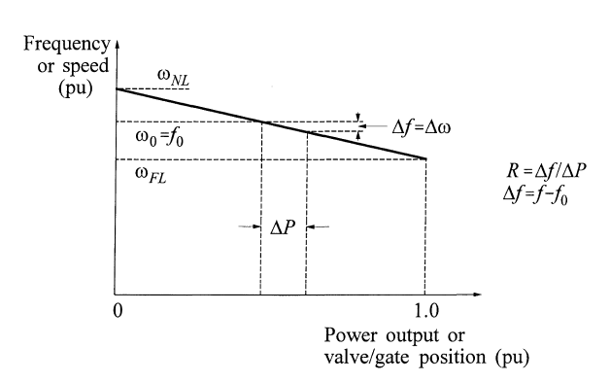
Speed-Load characteristics
Power System Operation and Control

Slide 14
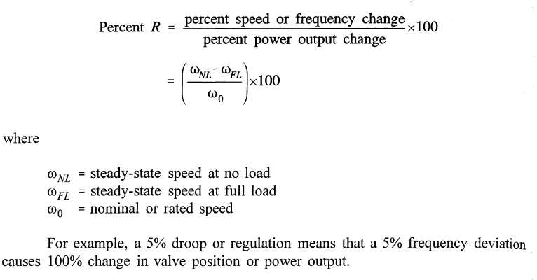
Speed-Load characteristics
The parameter R is referred to as speed regulation or droop. It can be expressed in percent as
Power System Operation and Control

Slide 15
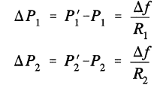
Load sharing between two synchronous machine in parallel
If two or more generators with drooping governor characteristics are connected to a power system, there will be a unique frequency at which they will share a load change
They are initially at nominal frequency f₀,with outputs P₁ and P₂.
When a load increases ΔP_{L} causes the units to slow down, the governors increase output until they reach a new common operating frequency f’.
The amount of load picked up by each unit depends on the droop characteristics:
Power System Operation and Control

Slide 16

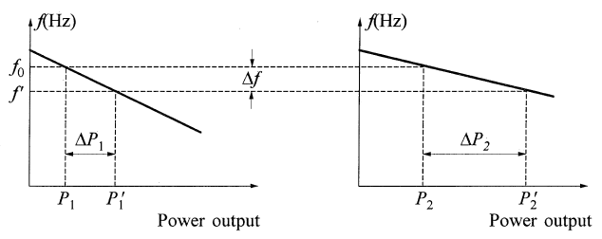
Load sharing between two synchronous machine in parallel
Hence
If the percentage of regulation of the units are nearly equal, the change in the outputs of each unit will be nearly in proportion to its rating
Load sharing by parallel units with drooping characteristics
Power System Operation and Control

Slide 17
Control Area
Definition
  It is defined as a power system, a part of a system or combination of systems to which a common generation control scheme is applied.
  The electrical interconnection within each control area is very strong as compared to the ties with the neighboring areas.
  All the generators in a control area swing in coherently or it is characterized by a single frequency
  It is necessary to be considered as many control area as number of coherent group.
Power System Operation and Control

Slide 18
Control Area
AGC problem of a large interconnected power system has been studied by dividing a whole system into a number of control areas.
In normal steady state operation, each control area of a power system should try to compensate for those demand in power.
Simultaneously, each control area of a power system should help to maintain the frequency and voltage profile of the overall systems.
Power System Operation and Control

Slide 19
Load Frequency Control of Single area system
Speed Governor
Turbine
Power system
Complete Block diagram representation of LFC
- Uncontrolled case
or
Primary control loop
Power System Operation and Control

Slide 20
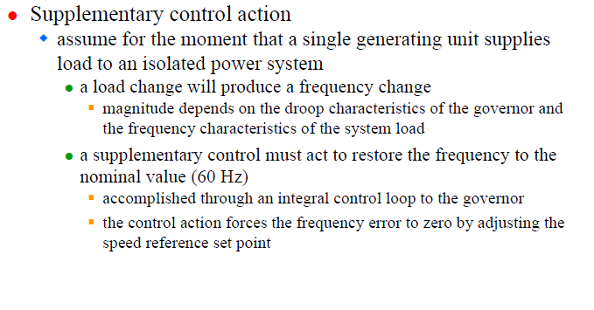
Power System Operation and Control

Slide 21

Complete Block diagram representation of LFC
-Controlled case
or
Integral control loop
1
Speed Governor
Turbine
Power system
Integral controller
Primary LFC loop
Secondary or Supplementary LFC loop controller
Power System Operation and Control

Slide 22
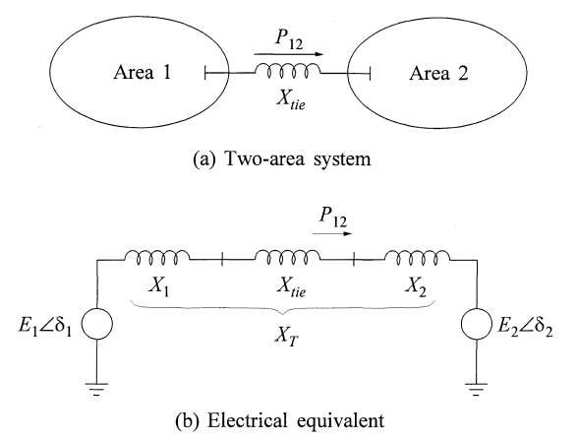
TWO AREA SYSTEM OR MULTI AREA SYSTEM
Power System Operation and Control

Slide 23
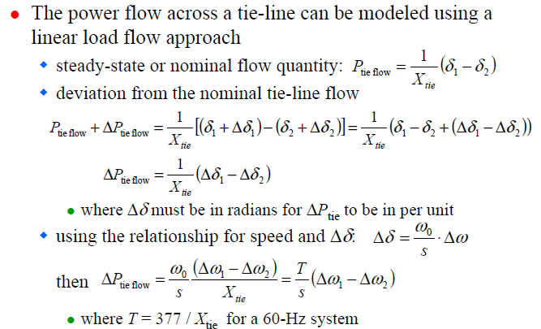
Tie-line Model
Power System Operation and Control

Slide 24
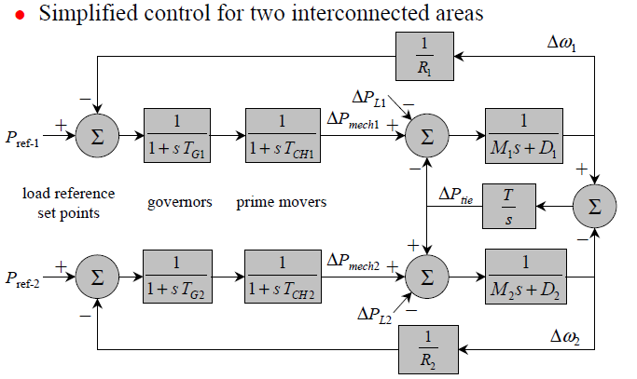
TWO AREA SYSTEM
Power System Operation and Control

Slide 25
Tie-line Model
Consider two areas each with a generator
  the two areas are connected with a single transmission line
  the line flow appears as a load in one area and an equal but negative load in the other area
  the flow is dictated by the relative phase angle across the line, which is determined by the relative speeds deviations
  let there be a load change ΔP_{L1} in area 1
  to analyze the steady-state frequency deviation, the tie-flow deviation and generator outputs must be examined
Power System Operation and Control

Slide 26
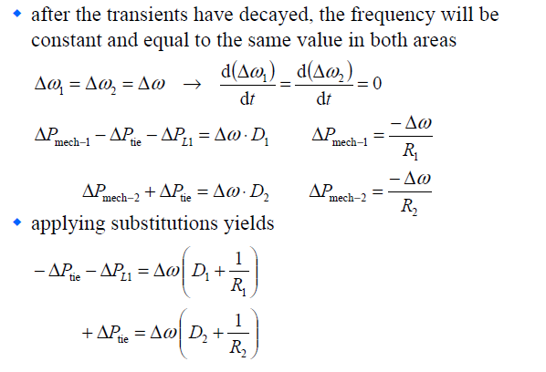
Tie-line Model
Power System Operation and Control

Slide 27
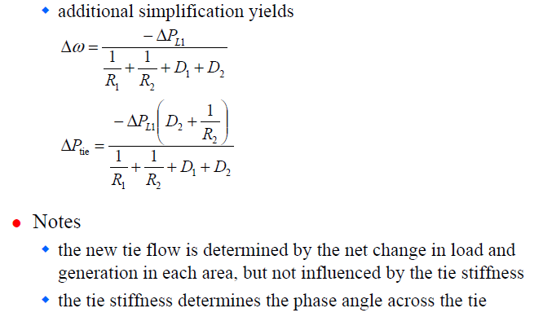
Tie-line Model
Power System Operation and Control

Slide 28
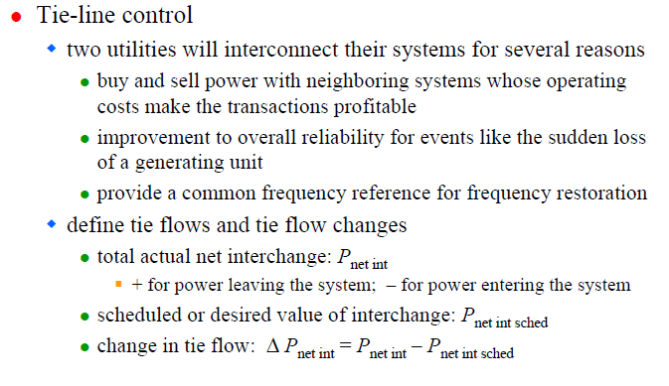
Tie-line Model
Power System Operation and Control

Slide 29
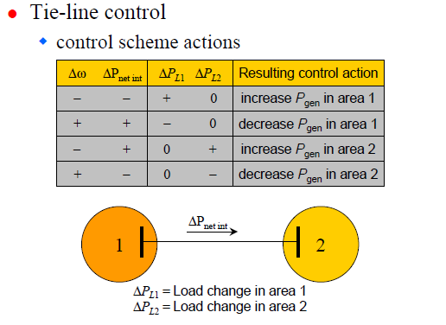
TIE - LINE CONTROL
Power System Operation and Control

Slide 30
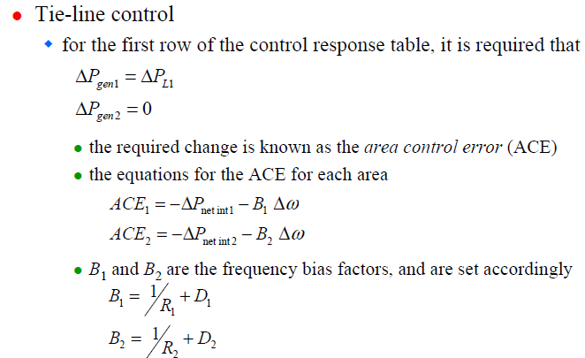
TIE - LINE CONTROL
Power System Operation and Control

Slide 31
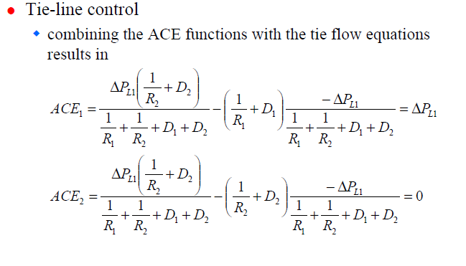
TIE - LINE CONTROL
Power System Operation and Control

Slide 32
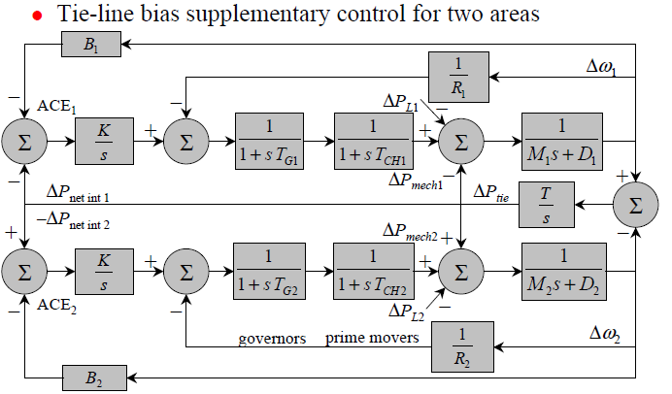
TWO AREA SYSTEM OR MULTI AREA SYSTEM
Power System Operation and Control

Slide 33
Power System Operation and Control

